Slide 1
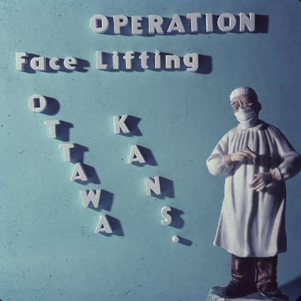
Slides From 1964-65

Slide 2
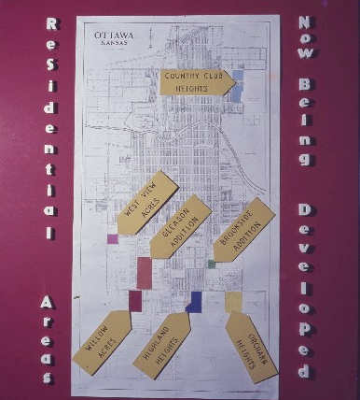

Slide 3
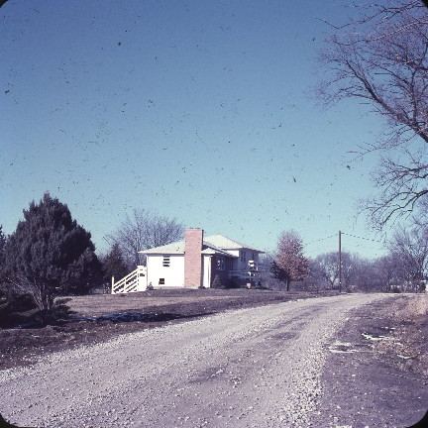
Country Club Heights

Slide 4
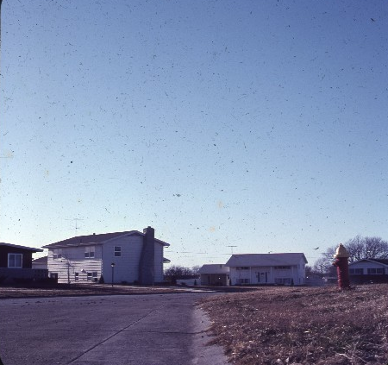
Willow Acres

Slide 5
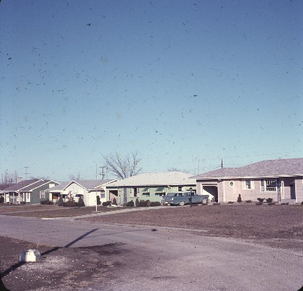
Highland Heights

Slide 6
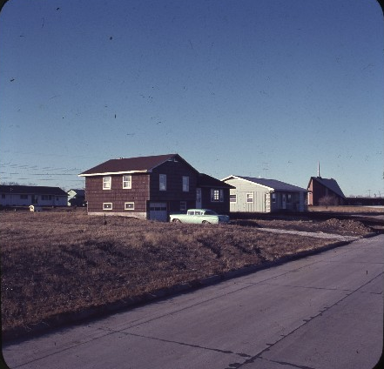
Gleason Addition

Slide 7
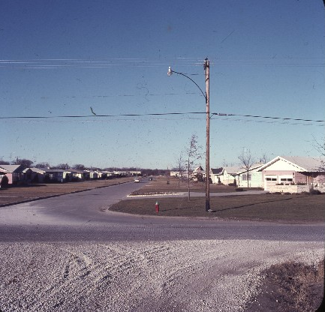
Gleason Addition 2

Slide 8
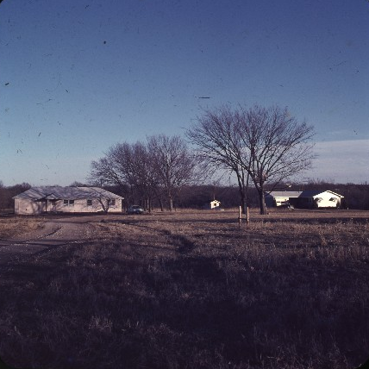
Brookside Addition

Slide 9
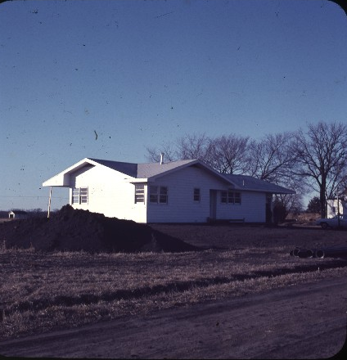
West View Acres

Slide 10
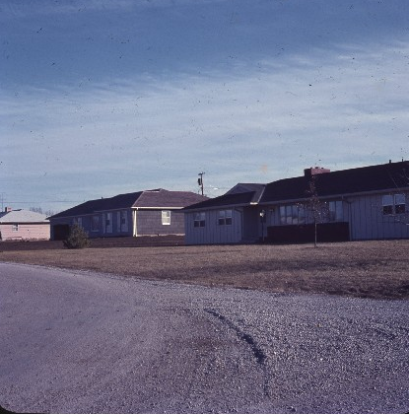
Orchard Heights

Slide 11
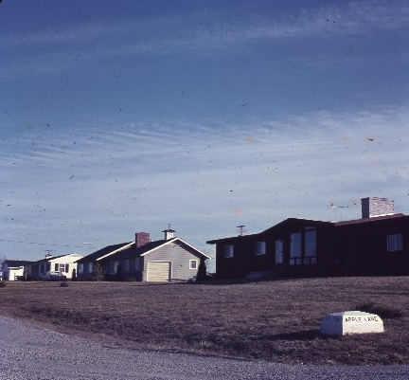
Orchard Heights 2

Slide 12
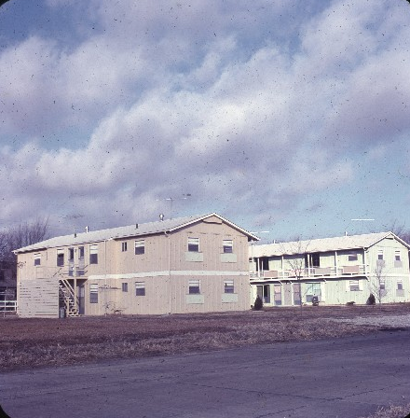
Apartments

Slide 13
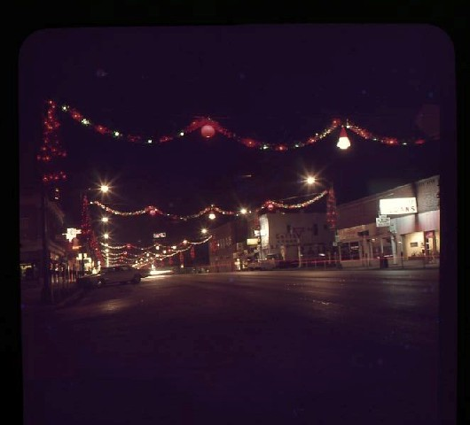
Downtown Ottawa Christmas

Slide 14
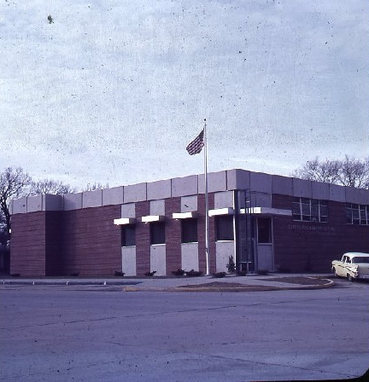
New
U.S. Post Office

Slide 15
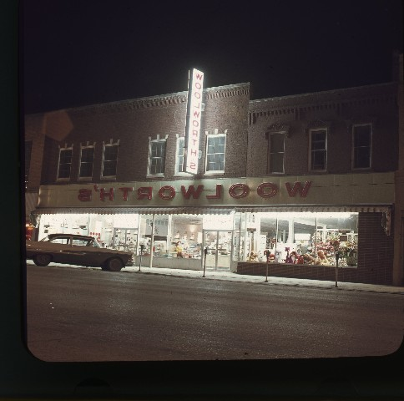
Woolworth’s

Slide 16
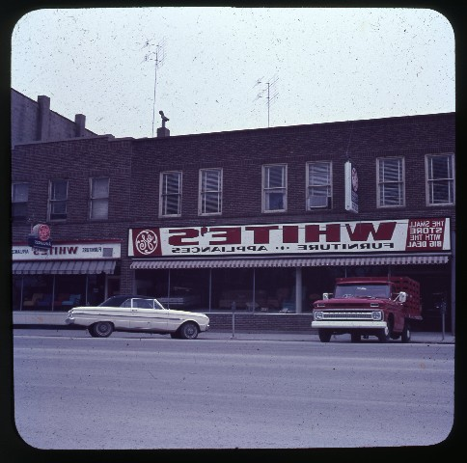
White’s Furniture & Appliances

Slide 17
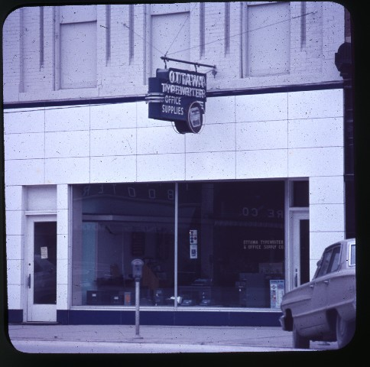
Ottawa Typewriter

Slide 18
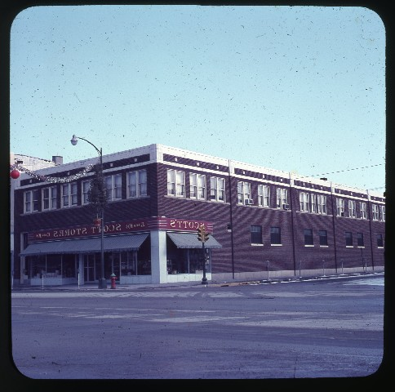
Scott’s

Slide 19
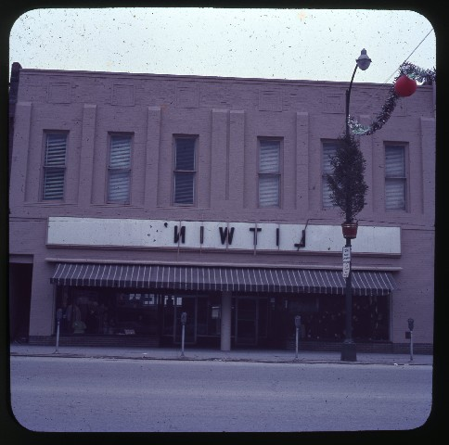
Litwin’s

Slide 20
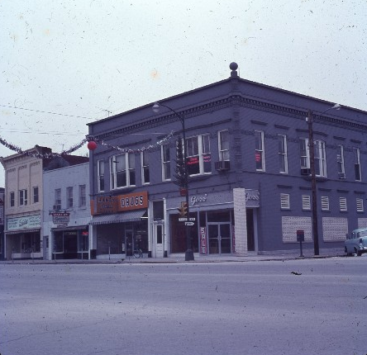
Goss’

Slide 21
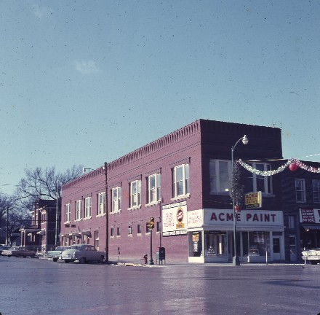
Acme Paint

Slide 22
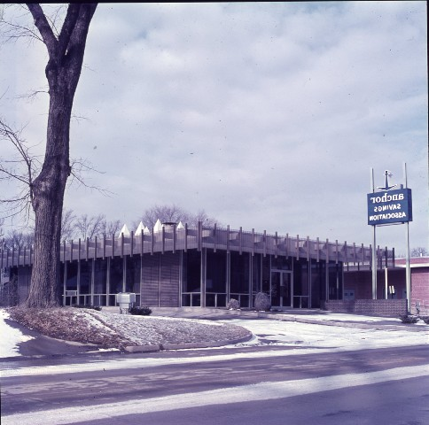
Anchor Savings

Slide 23
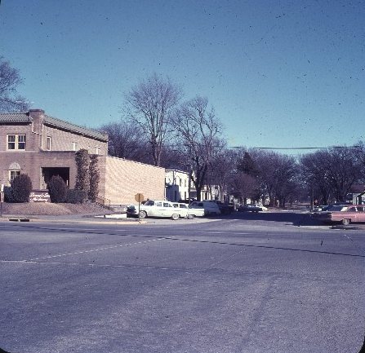
Dengel’s

Slide 24
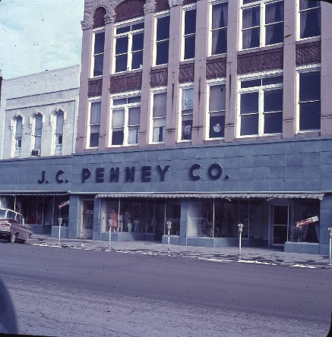
J.C. Penney Co.

Slide 25
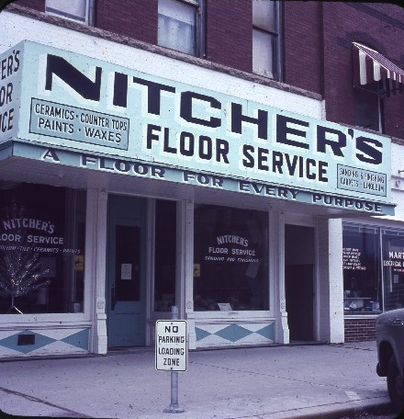
Nitcher’s Floor Service

Slide 26
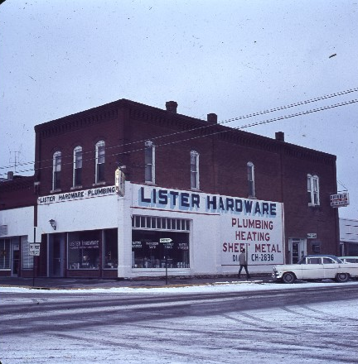
Lister Hardware

Slide 27
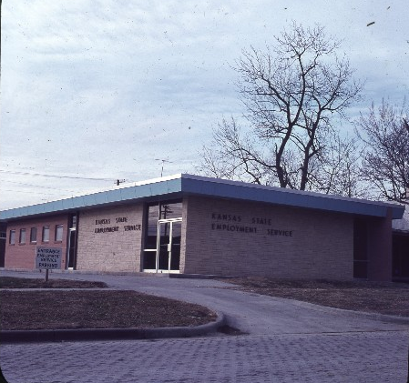
Kansas State Employ-ment

Slide 28
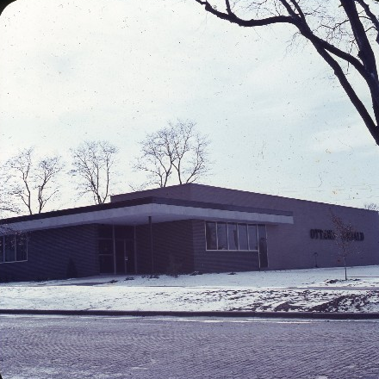
Ottawa Herald

Slide 29
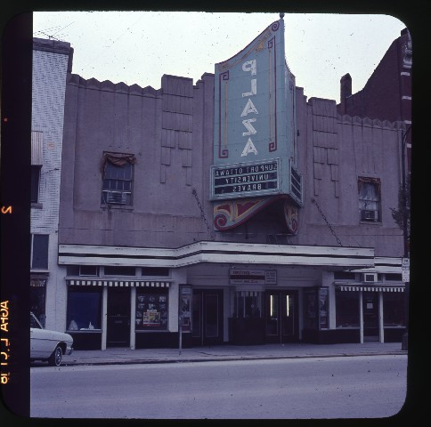
Plaza Theater

Slide 30
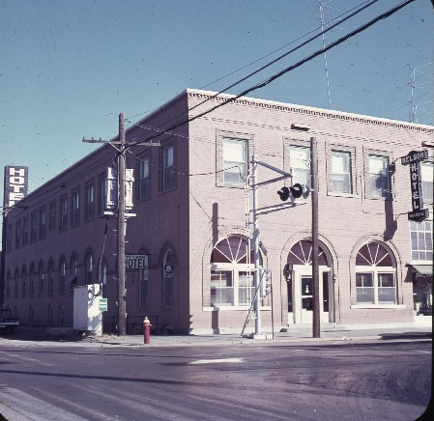
Nelson Hotel

Slide 31
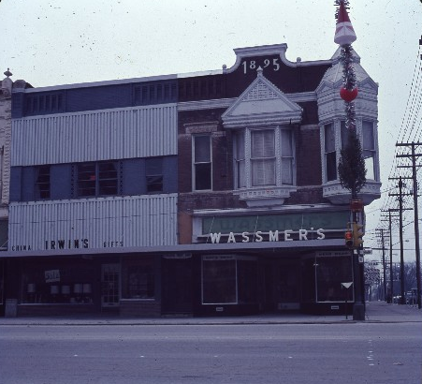
Lewin’s and Wassmer’s

Slide 32
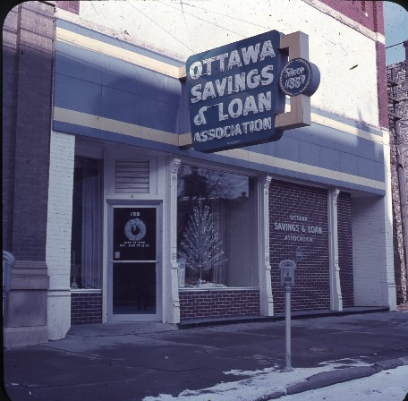
Ottawa Savings & Loan Assn.

Slide 33
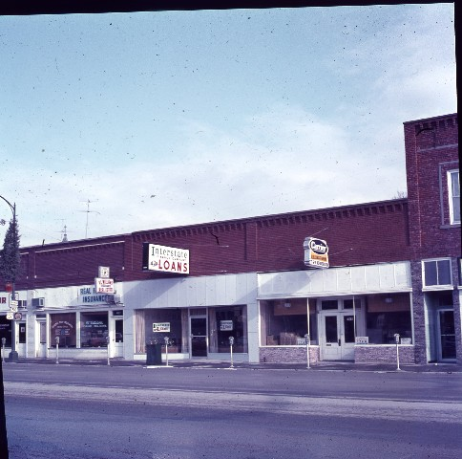
Interstate Loans

Slide 34
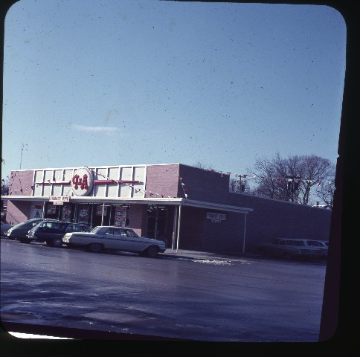
A&P Grocery Store

Slide 35
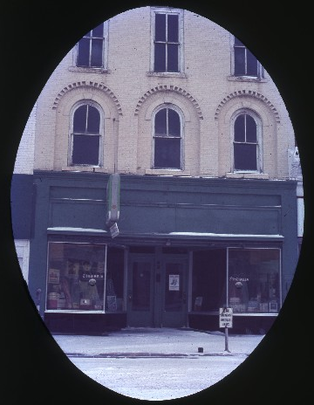

Slide 36
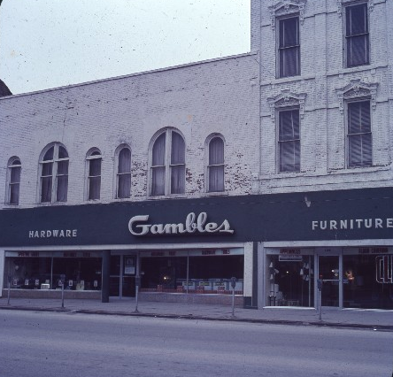
Gambles

Slide 37
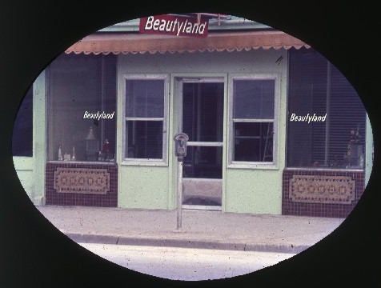
Beautyland

Slide 38
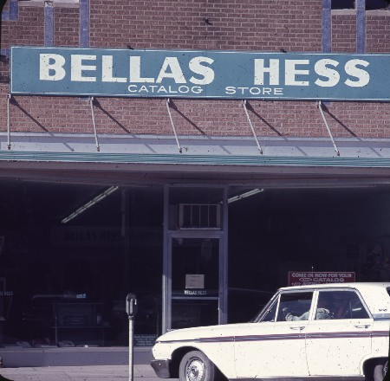
Bellas Hess Catalog store

Slide 39
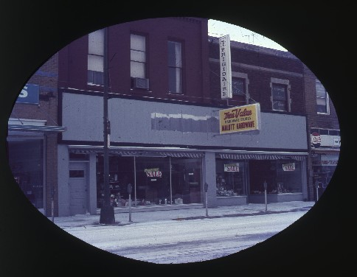
TruValue Handware

Slide 40
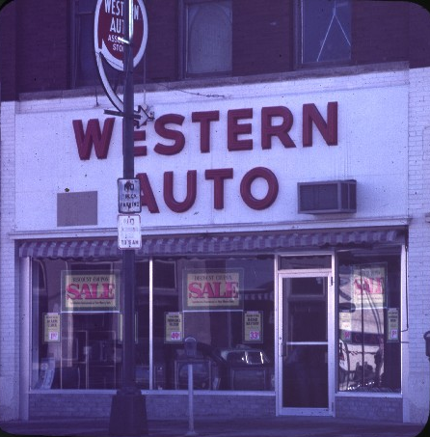
Western Auto

Slide 41
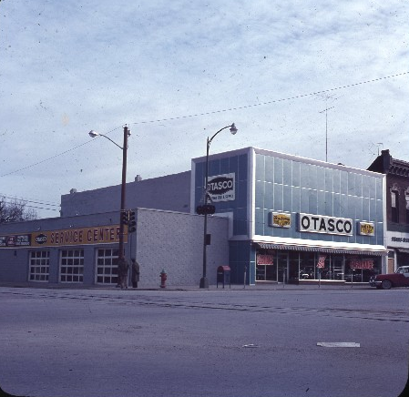
Oklahoma Tire & Supply

Slide 42
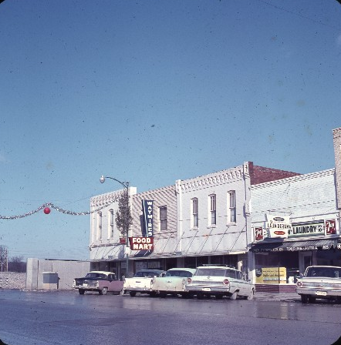
Waymire’s Food Mart

Slide 43
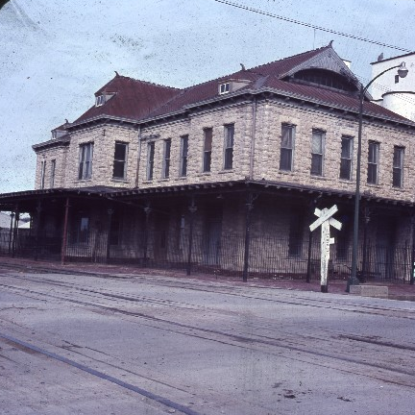
Old Santa Fe Passenger Depot

Slide 44
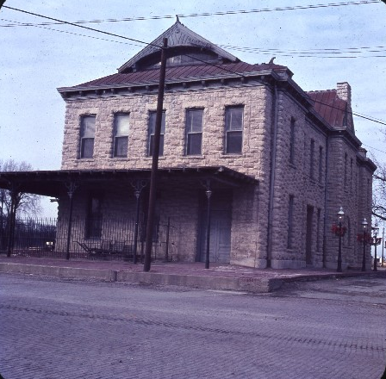
Old Depot Museum

Slide 46
